Slide 1
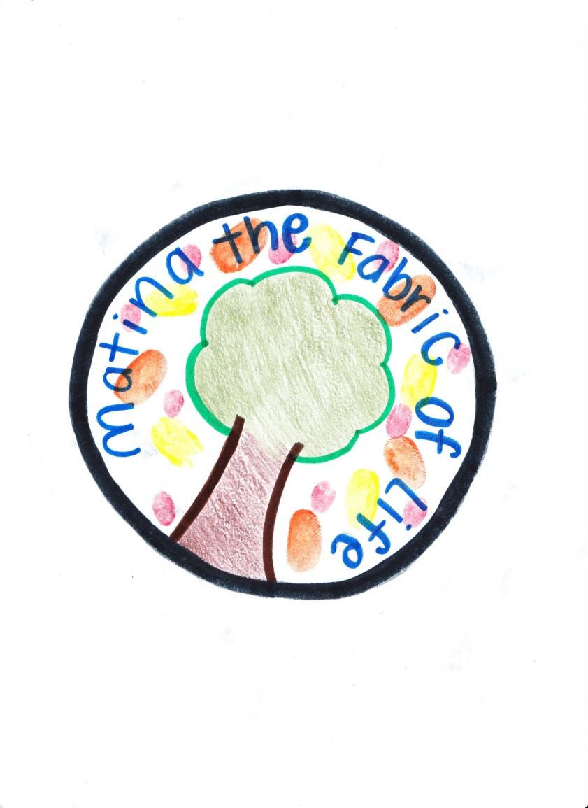
Accogliente
Patina Hunt
My Tran

Slide 2
What is Accogliente?
Designed by Matina: The Fabric of Life, a company based in Texas
A special type of clothe that can change between a sweater, tank top, crop top, and T-shirt
Adjustable temperature depending on the environment and one’s body temperature
Waterproof
Adjustable size based on the customer’s body physique
Sweat-resistant

Slide 3
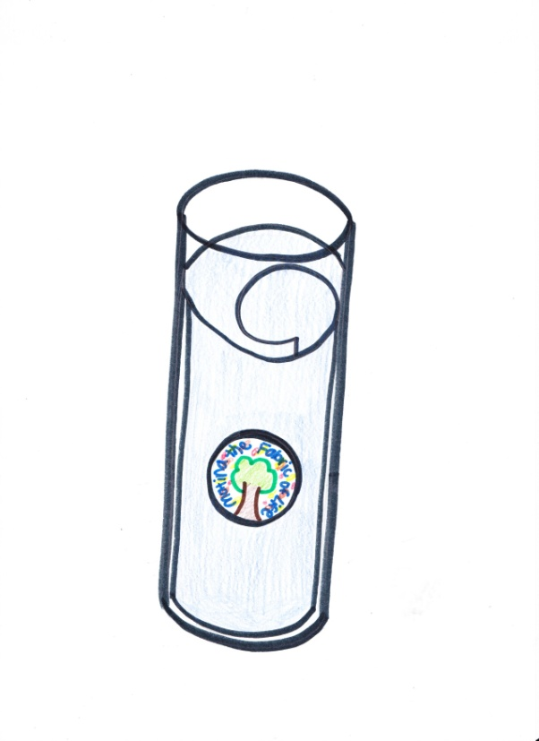
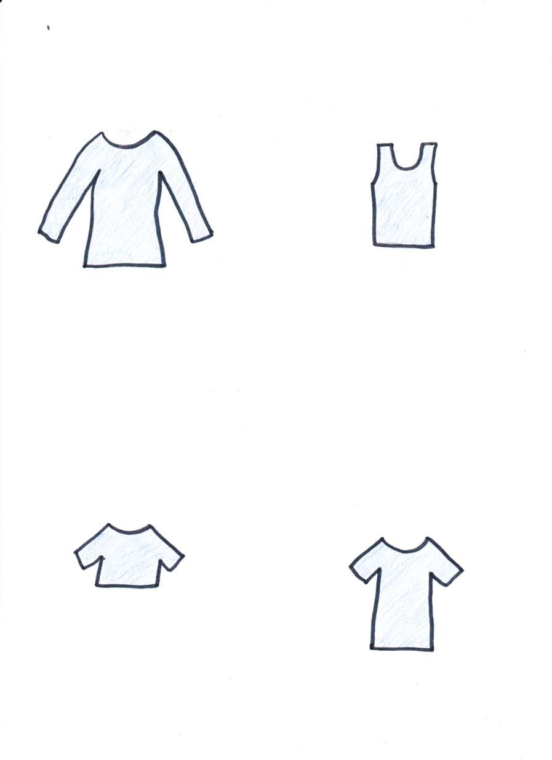
Packaging and Product

Slide 4
Benefits of Accogliente
Helps people save money and places in their closet
It is durable so customers do not have to constantly buy new ones
Less materials being thrown away
Allows creative people to design their own clothe based on their liking

Slide 5
Market Targets
Accogliente is designed to target anyone who can afford to buy it
It is great for babies, kids, teenagers, middle-aged, and elders who want to save a few bucks and places in their closets
Inexpensive and a super deal for its many uses – ONLY $49.94

Slide 6
Competitions
Clothing industry, such as:
REI
Nordstrom
Macy’s
Sport Chalet
JCPenney
Kohl’s
Bloomingdale’s

Slide 7
Factors Needed to be Considered
Labor
Number of people to hire
Wages and benefits
Facility
Machineries
Safety
Raw Material
Special type of cotton that is durable
Technology
A scanner for design
Automatic adjustable temperature controller
Special body shape’s adjuster

Slide 8
Make-sourcing
Generate incomes for the country, especially for the areas around the company’s location and facilities
Boost morale
Increase employment
Total control over the schedule of our own production
Higher protection of patents and technology

